Slide 1

CSC 808 Computer Logic Designs Lecture Note 2 Ass. Prof O. N. akande
Lecturer:
Akande Noah O. (Ph. D.)
Notes:
CYB 482

Slide 2
Computer Logic Designs
The study of digital logics is fundamental to Computer Architecture as it provides the building blocks for designing and understanding modern computing systems.
It enables engineers to grasp how logic gates, Boolean algebra, combinational and sequential circuits form the foundation of processors, memory units, and control logic in computers.
Digital logic is essential for understanding how CPUs execute instructions, perform arithmetic operations, manage data flow, and communicate with peripherals.
In addition, Digital Logic Design is used to develop hardware, such as circuit boards and microchip processors.

Slide 3
Key Components of Digital Logic
Logic Gates: Basic building blocks of circuits (AND, OR, NOT, XOR, NAND, NOR).
Boolean Algebra: The mathematical framework for logic operations.
Combinational Logic: Circuits like multiplexers, decoders, and adders that compute without memory. E.g. Calculators
Sequential Logic: Uses memory elements (flip-flops, registers) to store state information. E.g. Digital Clocks
Finite State Machines (FSMs): Control logic for processors and embedded systems. E.g traffic lights and elevators

Slide 4
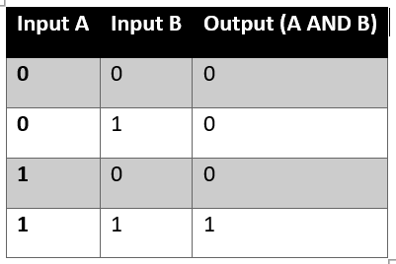
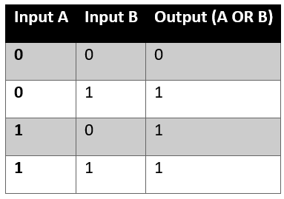
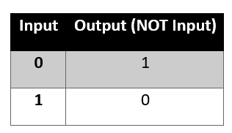
Logic Gates
There are seven basic types of logic gates:

Slide 5
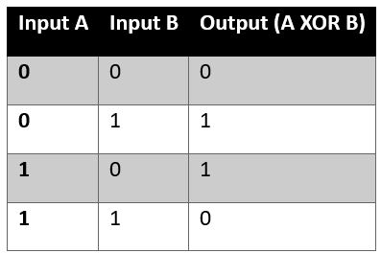
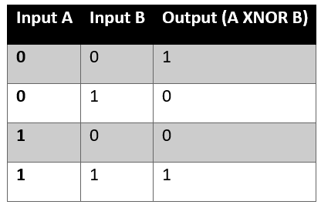
Logic Gates
NAND and NOR

Slide 6
Introduction to Boolean Algebra
Boolean Algebra is a mathematical framework used for analyzing and designing digital circuits in computer architecture.
Basic Boolean Operations:
AND (· or ∧): Outputs 1 only if both inputs are 1. (A · B = AB)
OR (+ or ∨): Outputs 1 if at least one input is 1. (A + B)
NOT (¬ or ̅): Inverts the input (A̅ means NOT A).

Slide 7
Laws of Boolean Algebra
i. Identity Law: A + 0 = A, A · 1 = A
ii. Null Law: A + 1 = 1, A · 0 = 0
iii. Idempotent Law: A + A = A, A · A = A
iv. Complement Law: A + A̅ = 1, A · A̅ = 0

Slide 8
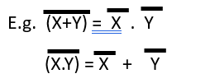
Laws of Boolean Algebra
v. De Morgan’s Theorems: De Morgan’s Theorem states that “an entire function could be complemented by replacing AND operators with OR operator, and vice versa; as well as complementing every variable and literal”.

Slide 9

Laws of Boolean Algebra
Use De Morgan’s Theorems to simplify this:

Slide 10
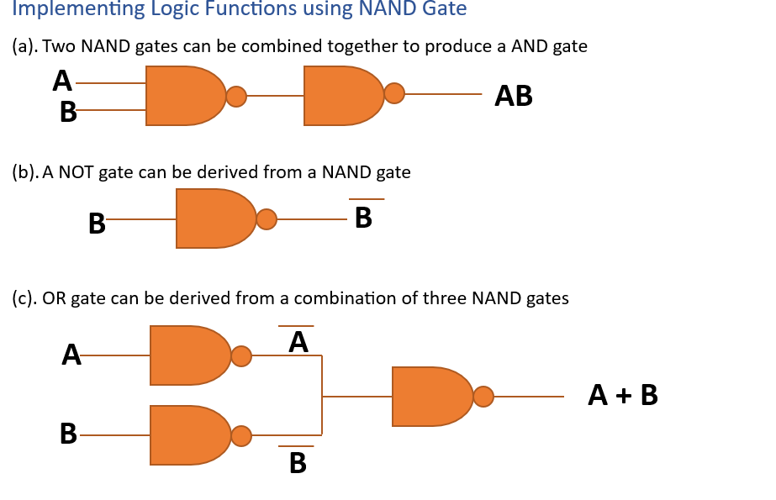
Implementing Logic Functions
This illustrates how to convert/derive one logic gate function from another, especially with NAND and NOR gates because they operate at a higher speed than AND & OR gate

Slide 11
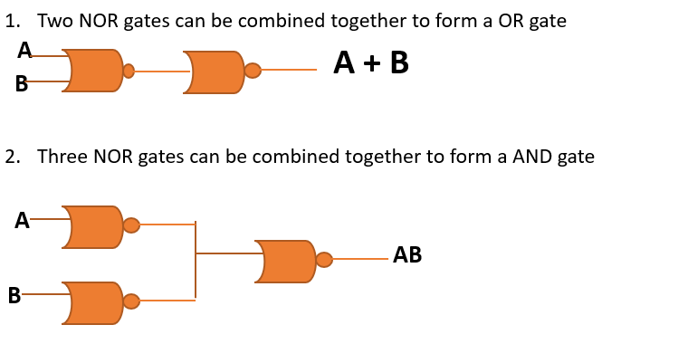
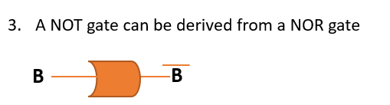
Implementing Logic Functions using NOR Gate

Slide 12
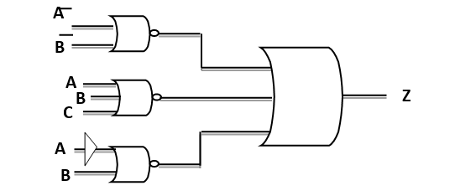
Exercises
Convert the gate network below to a NAND to NOR gate network.

Slide 13
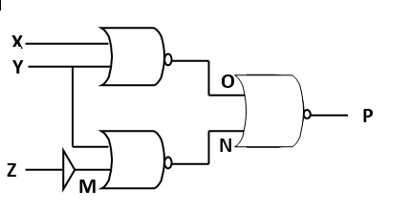
Exercises
Identify the logic circuit network, values of outputs M, N, O and P and convert the circuit to a NAND to AND gate network.

Slide 14
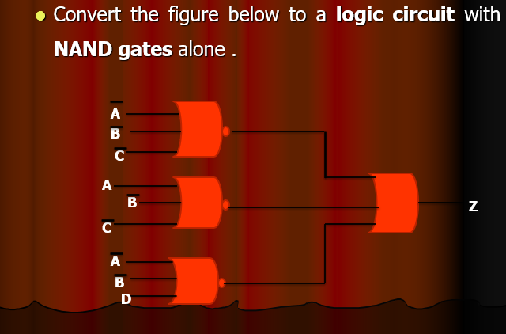
Exercises

Slide 15
CSC 808 Combinational Logic Circuit Design Lecture Note 3 Ass. Prof O. N. akande
Lecturer:
Akande Noah O. (Ph. D.)
Notes:
CYB 482

Slide 16
Combinational Logic Circuit Design
A combinational logic circuit is a type of digital circuit where the output depends only on the present inputs and not on any past inputs or states.
They perform logical operations using basic logic gates and provide an immediate output for any given set of input values.

Slide 17
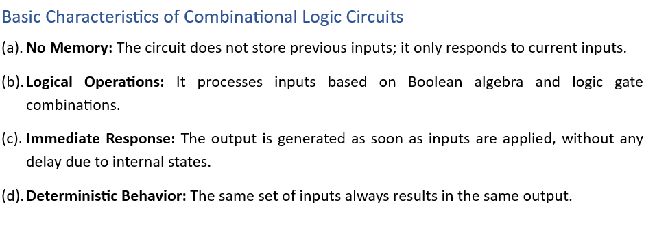
Combinational Logic Circuit Design

Slide 18
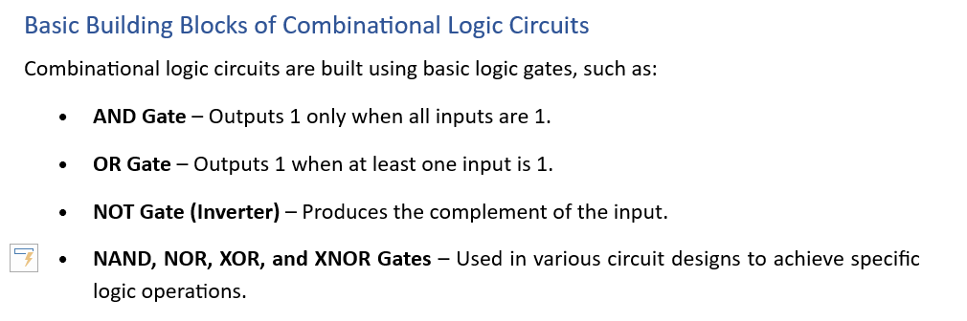
Combinational Logic Circuit Design

Slide 19
Combinational Logic Circuit Design
Combinational logic circuits can be constructed by using both Sum of Products (SOP) and Products of Sum (POS) terms.
It can be further simplified using the Boolean algebra theorems

Slide 20
Sum of Products (SOP)
SOP (or Minterms) logic expressions consist of two or more AND terms (products) that are Ored together.
In other words, a SOP logic expression is formed by selecting product terms for which the OUTPUT is “1” and Oring them together.
Example XYZ + X Y are in SOP form

Slide 21
Products of Sum (POS)
A POS (maxterms) consists of TWO or more OR terms that are ANDed together
In other words, a POS logic expression is formed by selecting product terms for which the OUTPUT is “0” and ANDing them together.
Example (X+Y+Z) (X+ Y + Z) are in POS form

Slide 22
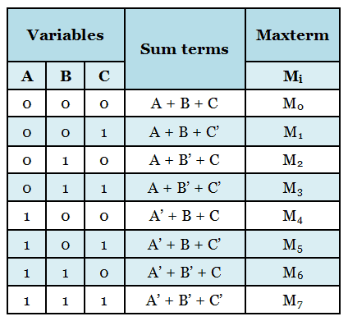
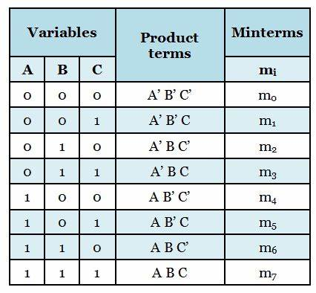
Combinational Logic Circuit Design

Slide 23
Exercise
A logic network has two inputs X and Y and an Output Z. The relationship between the input and output is given below:
When both X & Y are 0, Z is 1
When X is 0 and Y is 1, Z is 0
When X is 1 and Y is 0, Z is 1
When X is 1 and Y is 1, Z is 1
Design a combinational network to implement this problem.

Slide 24
X | Y | Z
0 | 0 | 1
0 | 1 | 0
1 | 0 | 1
1 | 1 | 1
POS = X + Y
SOP = X Y + X Y + X Y
= Y ( X + X ) + X Y
= Y + X Y
= Y (X+1) + X Y
= X Y + Y + X Y
= X (Y + Y) + Y
= X + Y

Slide 25
X | Y | Z
0 | 0 | 1
0 | 1 | 0
1 | 0 | 1
1 | 1 | 1
Using perfect induction to prove that the answer is correct:
= X + Y
X | Y | Y | Z
0 | 0 | 1 | 1
0 | 1 | 0 | 0
1 | 0 | 1 | 1
1 | 1 | 0 | 1

Slide 26
Exercise
A logic circuit with three inputs X, Y, Z is to be designed. Assume that the designed relationship between the input and the output is shown in the table below:

Slide 27
Exercise
X | Y | Z | W
0 | 0 | 0 | 1
0 | 0 | 1 | 0
0 | 1 | 0 | 1
0 | 1 | 1 | 0
1 | 0 | 0 | 1
1 | 0 | 1 | 0
1 | 1 | 0 | 1
1 | 1 | 1 | 0
SOP = Z
POS =

Slide 28
Exercise
Use law of Boolean Algebra to simplify this expression:
(X + Y + Z) (X + Y + Z) (X + Y + Z) (X + Y + Z)

Slide 29
Exercise
A logic circuit has three inputs X, Y, Z and an output W. The output W gives a HIGH signal whenever the combinations of the inputs are all zeros or even. Whenever the combinations of the inputs are odd, a LOW output will be produced.
Draw a truth table to represent this scenario
Simplify the expression using either POS or SOP rules
Draw the logic circuit of the simplified expression.

Slide 30
Exercise
An analog-digital converter was designed to monitor the dc voltage of a 12v storage battery on an orbiting spaceship. The converter’s INPUT is a four bit binary number A B C D corresponding to the battery voltage in steps of 1v. The converter’s binary outputs are fed to a logic circuit that is to produce a HIGH output whenever the binary output is greater than 0110₂ = 6₁₀ that is when the battery voltage is greater than 6v
Draw a truth table to represent this scenario
From the truth table, obtain a simplified SOP expression using Boolean algebra techniques.
Draw the logic circuit of the simplified SOP expression.
Design a logic circuit to implement the expression using NAND gates only.

Slide 31
Exercise
A logic circuit has four inputs D, C ,B, A that is encoded in 8421 natural binary form. The inputs in the range 0000=0 to 1011=11 represents the months of the year from JANUARY (0) to DECEMBER (11). Inputs in the range 1100 to 1111 (i.e. 12-15) cannot occur. The output of the circuit is a logical one (1) if the month represented by the input has 31 days, otherwise the input is FALSE.
Draw a truth table to represent this scenario
From the truth table, obtain a simplified SOP expression using Boolean algebra techniques.
Draw the logic circuit of the simplified SOP expression.
Design a logic circuit to implement the expression using NAND gates only.

Slide 32
CSC 808 Simplifying Boolean functions using Karnaugh-map Lecture Note 3 Ass. Prof O. N. akande
Lecturer:
Akande Noah O. (Ph. D.)
Notes:
CYB 482

Slide 33
Karnaugh Map (KMap)
Karnaugh-Map (K-Map) is a graphical and a more effective approach for representing and simplifying Boolean expression.
2^{n} input truth table will have 2^{n} input K- Map.

Slide 34
Simplifying Boolean Functions using Karnaugh - Map
Two - Variable K-Map
One - Variable K-Map
A
0
1
0
1
A B | A B
A B | A B
B
A | A
0
1
AB
00
01
11
10
C
A B C | A B C | A B C | A B C
A B C | A B C | A B C | A B C
0
Three – Variable
K-Map
1

Slide 35
Four - Variable K-Map
AB
00
01
11
10
CD
A B C D | A B C D | A B C D | A B C D
A B C D | A B C D | A B C D | A B C D
A B C D | A B C D | A B C D | A B C D
A B C D | A B C D | A B C D | A B C D
00
01
11
10

Slide 36
How to use a K - Map
Determine the number of variable involved
Determine the form of Boolean expression (SOP or POS) that will be transferred from the truth table to the map.
Enter 1 entry for SOP and 0 for POS.
Group or loop the 1’s or 0’s on the map
Read the loop of 0’s or 1’s on the map and Simplify vertically and horizontally

Slide 37
Example 1
A | B | C | Z
0 | 0 | 0 | 1
0 | 0 | 1 | 0
0 | 1 | 0 | 0
0 | 1 | 1 | 1
1 | 0 | 0 | 0
1 | 0 | 1 | 0
1 | 1 | 0 | 1
1 | 1 | 1 | 0
USING SOP
AB
C
00
01
11
10
0
1 |  | 1
 | 1
1
Z= A B C + A B C + A B C

Slide 38
Example 2
AB
00
01
11
10
C D
1 | 1 | 1 | 1
1 |  |  | 1
1 |  |  | 1
1 | 1 | 1 | 1
00
01
11
10
Z = B + D

Slide 39
Example 3
AB
00
01
11
10
C D
 | 0 | 0
 | 0 | 0
00
01
11
10
Z = B D

Slide 40
Example 4
An analog to digital converter is monitoring the CD voltage of a 12v storage battery on an orbital spaceship. The converter’s input is a four-bit binary number A, B, C, D corresponding to the battery voltage in steps of 1v. The converter’s binary outputs are fed to a logic circuit that is to produce a HIGH output as long as the binary value is greater than 0110₂ = 6₁₀ .
Use K-Map to obtain a simplified SOP expression for the output.

Slide 41
A | B | C | D | Z
0 | 0 | 0 | 0 | 0
0 | 0 | 0 | 1 | 0
0 | 0 | 1 | 0 | 0
0 | 0 | 1 | 1 | 0
0 | 1 | 0 | 0 | 0
0 | 1 | 0 | 1 | 0
0 | 1 | 1 | 0 | 0
0 | 1 | 1 | 1 | 1
1 | 0 | 0 | 0 | 1
1 | 0 | 0 | 1 | 1
1 | 0 | 1 | 0 | 1
1 | 0 | 1 | 1 | 1
1 | 1 | 0 | 0 | 1
1 | 1 | 0 | 1 | 1
1 | 1 | 1 | 0 | 1
1 | 1 | 1 | 1 | 1
AB
00
01
11
10
CD
 |  | 1 | 1
 |  | 1 | 1
 | 1 | 1 | 1
 |  | 1 | 1
00
01
11
10
Z = A + BCD

Slide 42
How to use a K - Map
Determine the number of variable involved
Determine the form of Boolean expression (SOP or POS) that will be transferred from the truth table to the map.
Enter 1 entry for SOP and 0 for POS.
Group or loop the 1’s or 0’s on the map
Read the loop of 0’s or 1’s on the map and express it as SOP or POS

